Slide 1
AWS Honolulu User Group
High Availability in AWS
2018-04-19 – 3rd Meetup

Slide 2
Agenda
What is High Availability?
High Availability in AWS
Hands on activity

Slide 3
What is High Availability (HA)?
Assure a high level of operational performance for a given period of time
Minimize downtime and service interruptions
Regardless of how reliable your systems and software are, problems can occur that can bring down your applications or your servers
Highly available systems can recover from server or component failure automatically

Slide 4
High Availability in AWS
Elastic Load Balancers
Allow you to balance traffic across multiple servers (or containers)
Auto Scaling Groups
Allow you to increase/decrease your fleet size based on metrics and alerts
Availability Zones and Regions
Help you to ensure that your app survives disasters and datacenters outages
Others
S3, CloudFront, RDS, DynamoDB, etc.

Slide 5
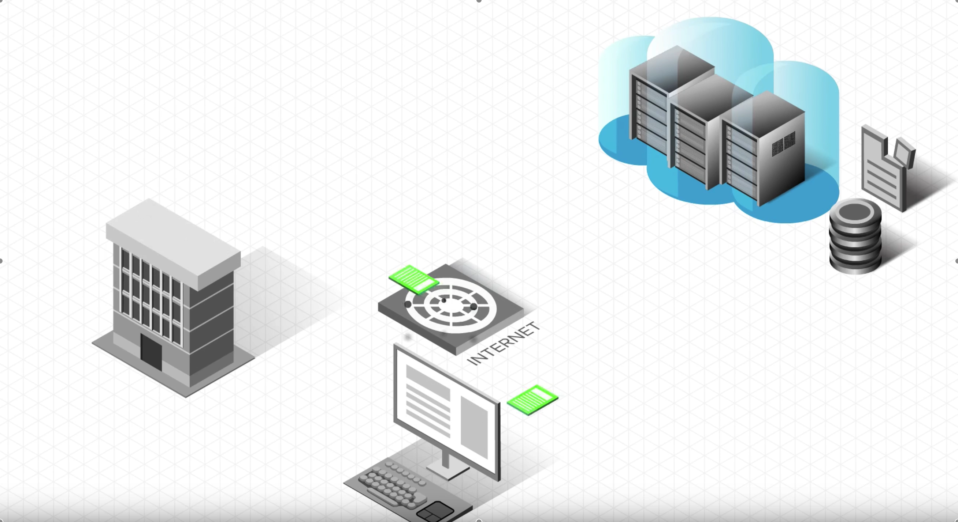
Load Balancers
Source: https://www.youtube.com/watch?v=9wlrcxBaE2w

Slide 6
Hands on activity
Clone the following repository:
https://github.com/awshonolulu/alb-deep-dives
Login to your AWS account
Go to IAM service, create a terraform user with programmatic keys and grab its keys
Configure Terraform with your access keys (env variables)
Run terraform init
Run terraform plan and analyze the resources that will be created
Run terraform apply
Add your Load Balancer DNS with your name at:
http://status-monitor.awshonolulu.com

Slide 7
Questions?

